Slide 1
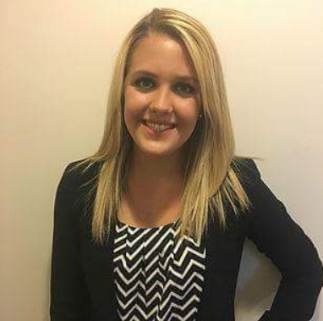

Kate Healy
Marketing Student at West Virginia University
Morgantown, West Virginia
kmhealy@mix.wvu.edu
(347)-860-2474
Notes:
Hi, my name is Kate Healy. I am a senior marketing student at West Virginia University. I am from Long Island, New York and I have lived their my entire life. Throughout this presentation, I will tell you about my interests, educational background, work experience, clubs and activities, and awards.

Slide 2
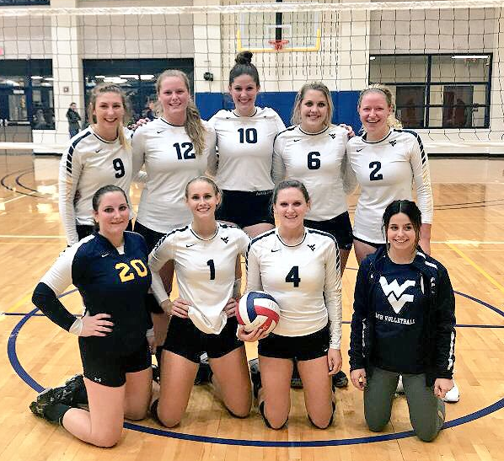
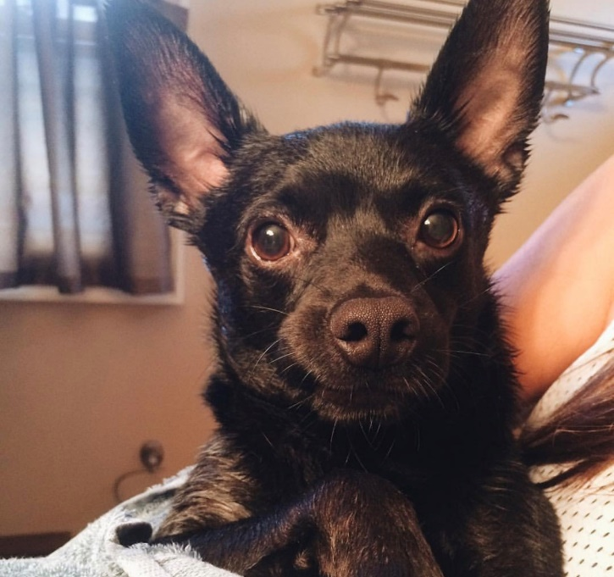
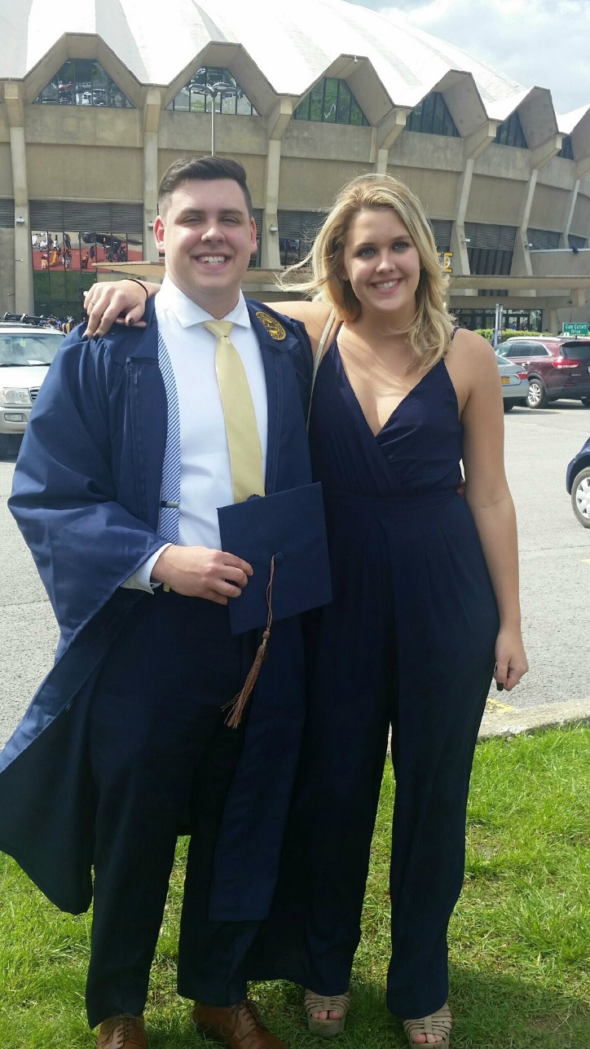
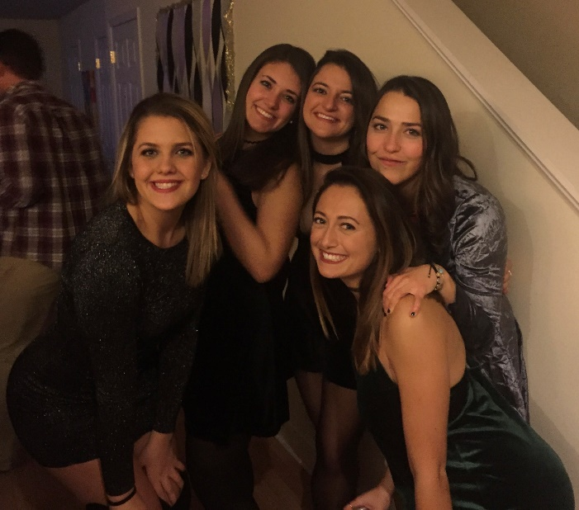
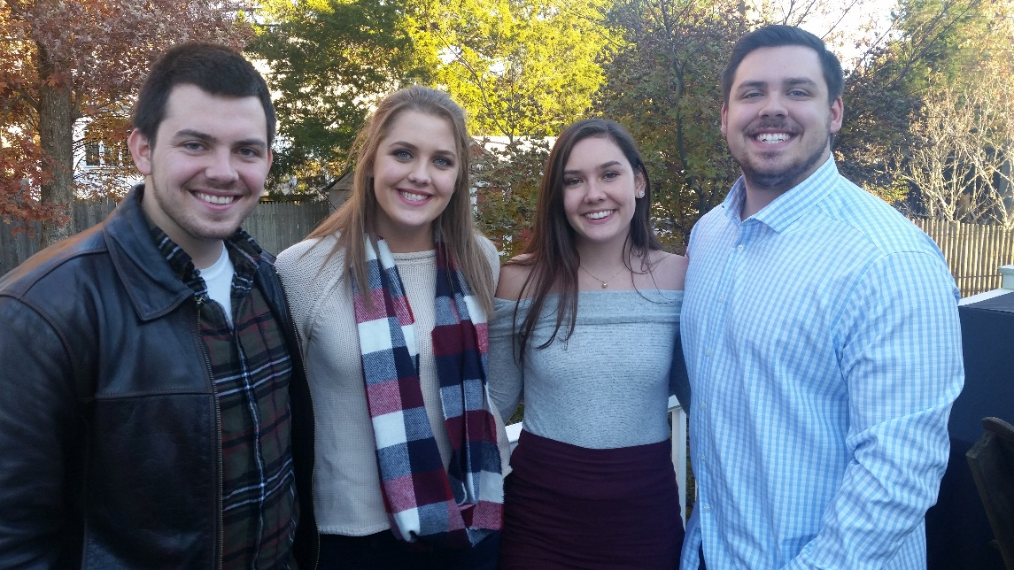
Interests:
Notes:
Some of my interests include my family, my friends, my volleyball team, and my dog. One of my favorite things to do with my family is driving across the United States of America. We have been to all 50 states! My friends and I like going to concerts, going to the beach, and eating.

Slide 3
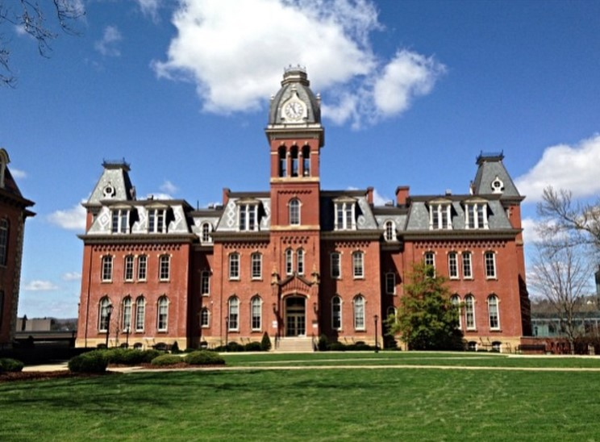
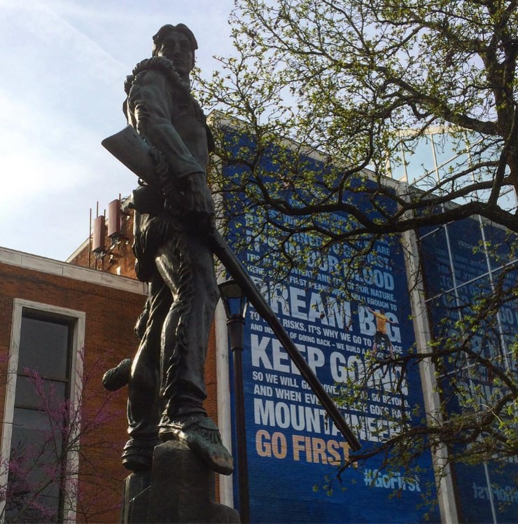
Education:
West Virginia University – College of Business and Economics
* AACSB accredited*
Major: Marketing
Overall GPA: 2.9/4.0 Major GPA: 3.4/4.0
Marketing/Business Course Work: Buyer Behavior, Marketing Research, Selling with Digital Media, Personal Selling, Principles of Marketing, Business Communications, Principles of Advertising, Principles of Accounting (Financial and Managerial), Legal Environment of Business, Information Systems/Technology, Business Finance, Managing Individuals & Teams, Principles of Microeconomics, and Principles of Macroeconomics, Price, Product, and Promotions, Supply Chain, and Retail Marketing
Notes:
This is my fourth year at West Virginia University. I am majoring in marketing and it is something I am extremely passionate about. Some of my favorite courses taken at this university have been Personal Selling, Research Marketing, and Buyer Behavior.

Slide 4

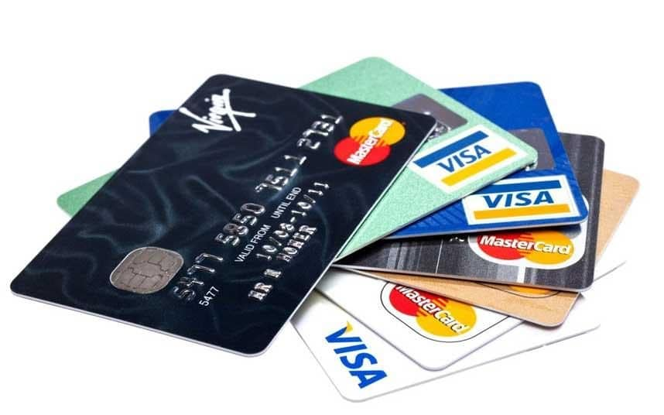
Work Experience:
Sales Intern at CardWorks
May 2017- August 2017
Woodbury, New York
• Sold credit card processing systems in Morgantown, WV
• Worked with a team of interns
• Developed communication, selling, and persistency skills
Notes:
Over the past summer I interned in Morgantown with a company that is based out of Woodbury, New York called CardWorks, I worked with a team of interns to sell credit card processing systems. Throughout this internship, I developed communication, selling, and persistency skills.

Slide 5


Work Experience:
Bartender/Waitress at Sports Page
May 2017 – August 2017
Morgantown, West Virginia
Capitalized on the importance of communication to build positive rapport with customers
Gained the ability to multitask and improved strategic thinking in situations that required urgency
Abided by local ABC laws and checked ID’s
Provided a clean environment
Notes:
After my internship during the past summer, I then worked at Sports Page in downtown Morgantown on High Street. I bartended and waitressed there. I learned multi-tasking skills and improved strategic thinking in situations that required urgency. I abided by local and federal laws by checking ID’s. It was also important to keep a cleanly work space for customers.

Slide 6

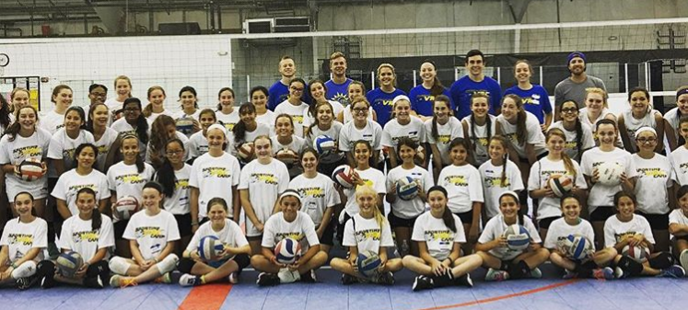
Work Experience:
Coach at Sportime Multi-Sport
Spring 2015 - Present
Bethpage, New York
• Taught high school students competitive volleyball
Scheduled tournaments, made rosters, and ordered uniforms
Developed leadership, coaching, and communication skills
Notes:
Since Spring 2015, I have worked at Sportime Multi-Sport as a coach in Bethpage, New York. I taught high school students competitive volleyball. My responsibilities included scheduling tournaments, making rosters, and ordering uniforms for the team. I have developed leadership, coaching, and communication skills.

Slide 7

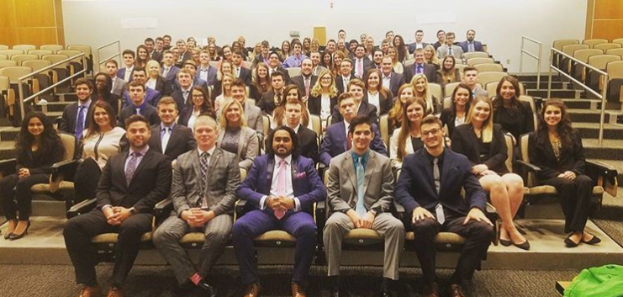
Clubs and Activities:
Delta Sigma Pi Nu Upsilon
Active Member
Fall 2016 – Present
Meet weekly to attend meetings
Attend professional development events
Volunteer throughout the community
Fundraise for local organizations
Notes:
I am an active member in Delta Sigma Pi Nu Upsilon since Fall 2016. Through this business fraternity, I have the responsibility to attend weekly meetings and professional development events. We also collectively raise money to help organizations in our community. This has given me networking skills, and has helped develop me professionaly.

Slide 8

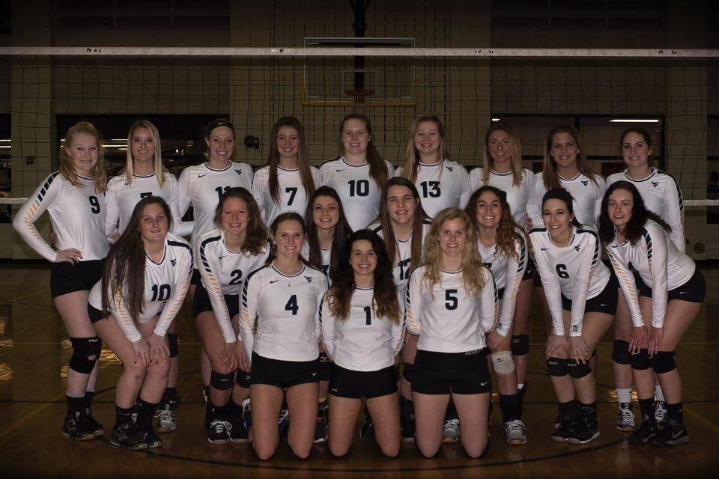
Clubs and Activities:
West Virginia University Women’s Club Volleyball
Treasurer
Fall 2014 – Present
Manage financial statements
Travel to nearby schools to participate in competitive tournaments
Book hotels and purchase necessary equipment
Notes:
I have been part of WV womens club volleyball since fall 2014. I have been on the A team all seven semesters. We have traveled as far as Louisville Kentucky and we are undefeated this semester and are going to Saint Louis, Missouri this upcoming April to compete in a national tournament. I became the Treasurer for my senior year. This job requires many responsibilities, such as managing financial statements, booking hotels and purchasing necessary equipment for the team.

Slide 9

Clubs and Activities:
American Marketing Association
Active Member
Fall 2016 – Present
Compete in case competitions with local companies
Attend business seminars and trainings
Network with marketing professionals
Notes:
I have been part of the American Marketing Associaton sicne fall 2016. This chapter is the first and only chapter in West Virginia. I have competed in case competions to help local companies. This club also provides business seminars and trainings as well as networking opportunities.

Slide 10



Skills:
Photoshop
Event Planning
Social Media
Blogging
Microsoft Office
SEO
Notes:
Some of my skills include Photoshop, Event Planning, Social Media Marketing, Blogging, Office, and search engine optimization

Slide 11



Awards:
WVU Blue & Gold Academic Scholarship
Fall 2014 – Spring 2016
Silver Award – Girl Scouts of America
May 2012
Notes:
I received the WVU Blue and Gold Academic Scholarship. I obtained this scholarship from Fall 2014- Spring 2016.
I also received the highest honor a girl scout cadet could earn. This was achieved through volunteering and creating and managing a long-term project.

Slide 12

Social Media:
Twitter: @KatherineHealy_
Facebook: https://m.facebook.com/Katherine.healy.94?ref=bookmarks
Instagram: @katehealy__
LinkedIn: https://www.linkedin.com/in/katherine-healy-054628a8/
Wix: https://kmhealy2.wixsite.com/mysite
Notes:
If you would like to learn more about me follow me on the following social media accounts

